Slide 1
How people’s writing habits and happiness change with age

Slide 2
Organization
Part 1. Introduction
Part 2. Sentence length
Part 3. Terms frequency: Wordcloud
Part 4. What are the differences in happiness among different age groups.
td-idf
Latent Dirichlet allocation(LDA)

Slide 3
Part 1. Introduction
According to American institute of human development, there are four significant life stages in one's life time:
Adolescence (Ages 12-20)
Early Adulthood (Ages 20-35)
Midlife (Ages 35-50)
Mature Adulthood (Ages 50-80).
How people's writing habits and happiness get changed as they move across life stages.

Slide 4
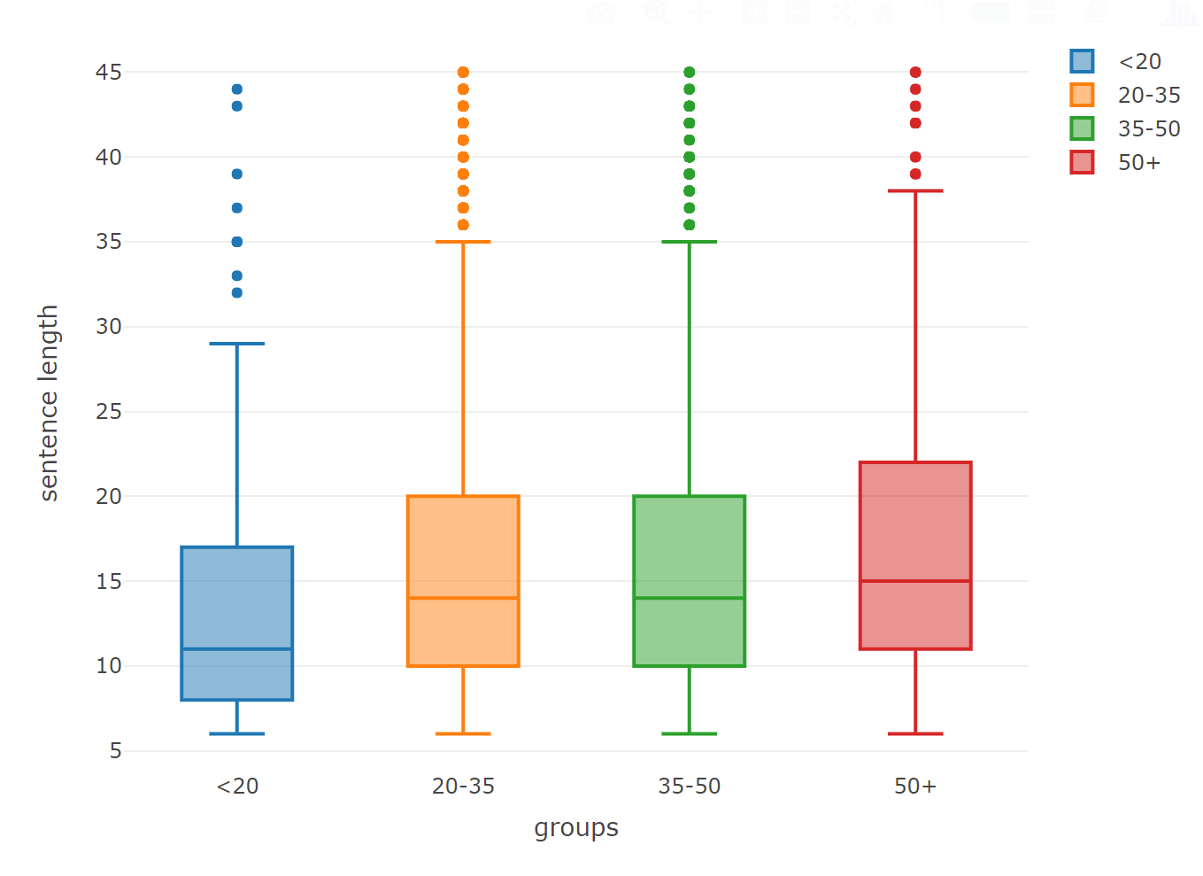
Part 2. Sentence length

Slide 5
Part 2. Sentence length
But based on a report from Harvard university, two reasons might be related to this phenomenon.
First, people's brain degenerates as aging, and as a result, people can't think of precisely the word they are looking for. So, they use longer sentence to express themselves since they can't think out some of the "precise" words when writing.
Second, people's brain becomes better at seeing the entire forest and worse at seeing the leaves with age. Thus, older people might write a longer sentence since they tend to show the whole picture.

Slide 6

Part 3. Terms frequency: Wordcloud

Slide 7
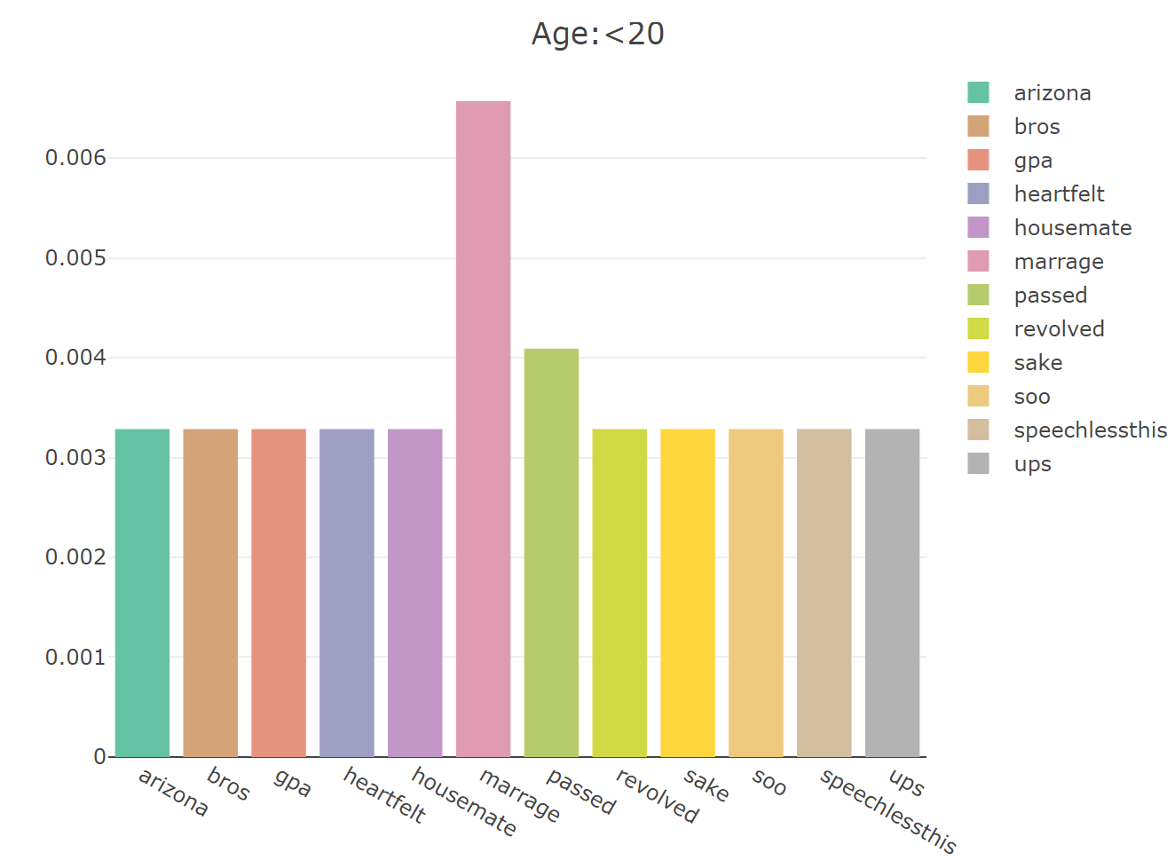
Part 4. What are the differences in happiness among different age groups(td-idf)

Slide 8
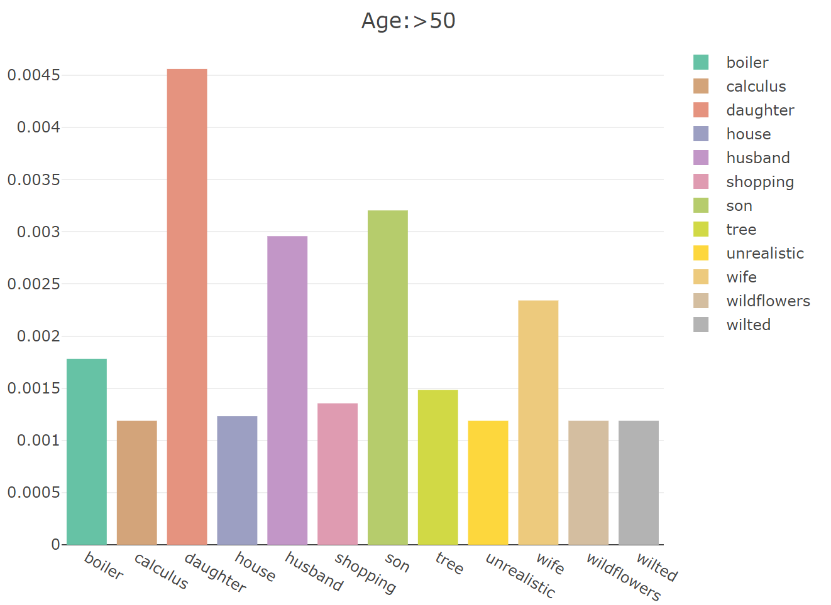
Part 4. What are the differences in happiness among different age groups(td-idf)

Slide 9
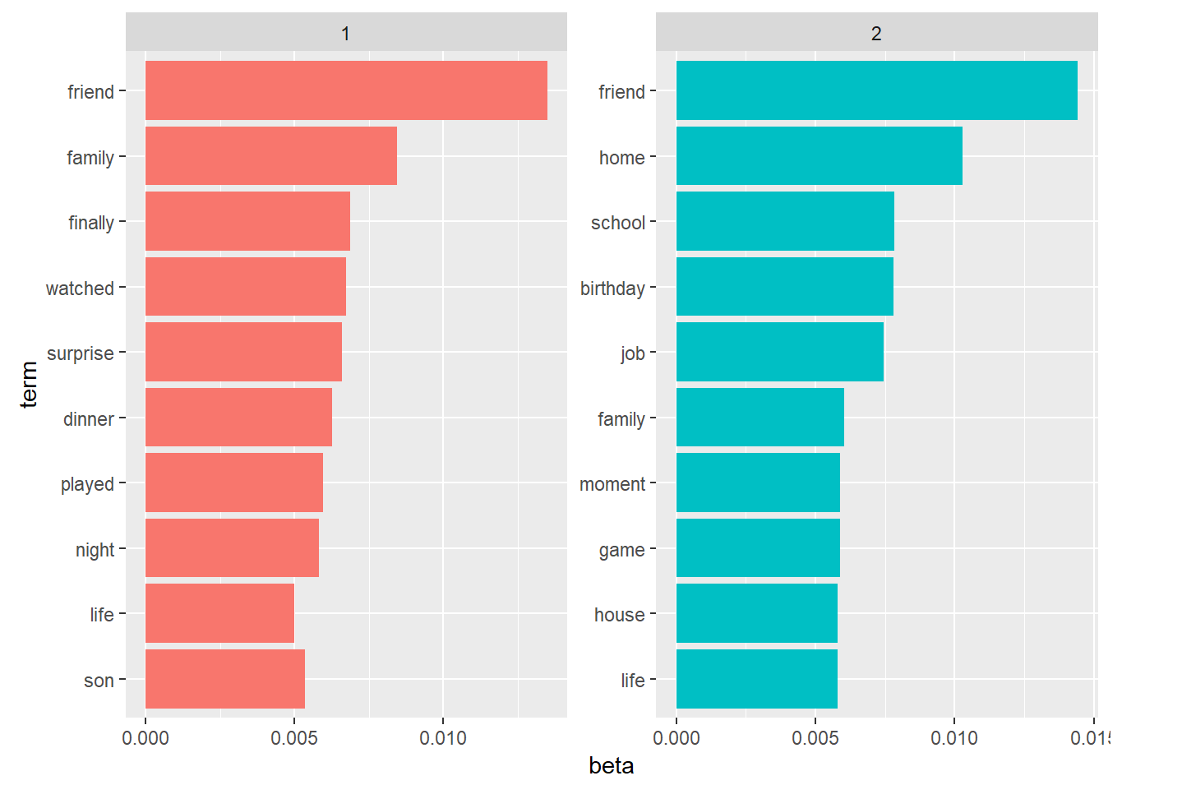
Part 4. What are the differences in happiness among different age groups(LDA)

Slide 10
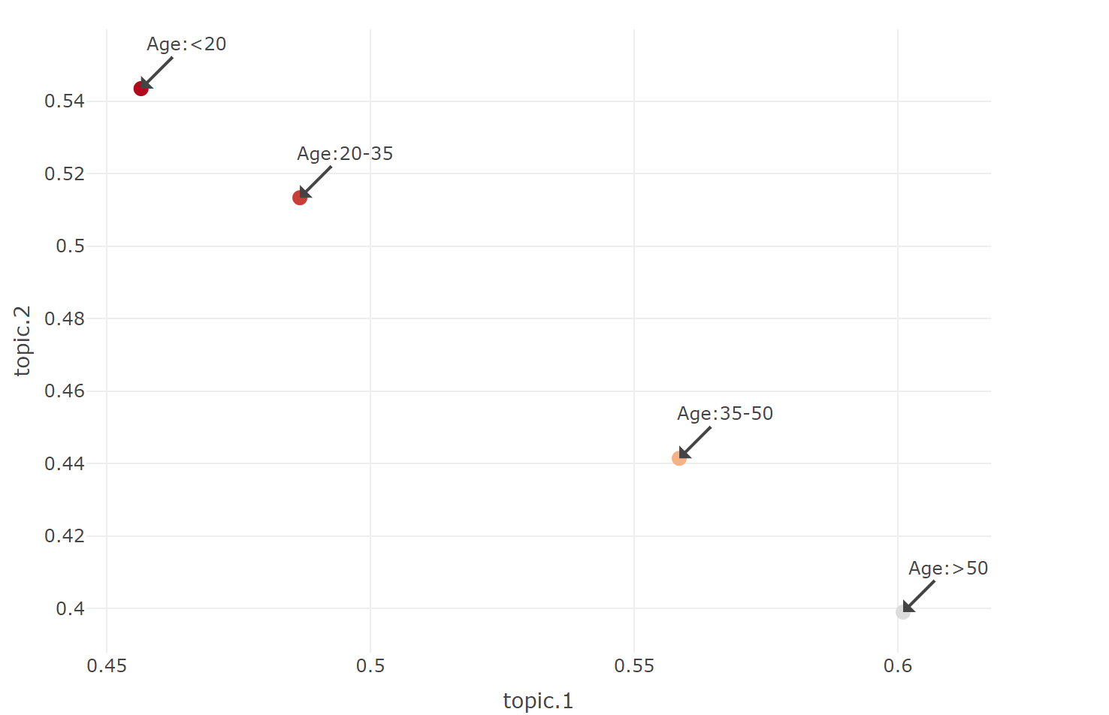
Part 4. What are the differences in happiness among different age groups(LDA)

